Slide 1
Improving Search applied to Running Dinner Problem
Justification of research and implemention
Josine Verkoeijen & Teun Voesenek, 9 Oktober 2023
Notes:
NL:
Improving Search toegepast op het Handelsreizigersprobleem
Verantwoording van onderzoek en implementatie

Slide 2
Contents
Problem definition
Math program
Research approach
Use of external sources like ChatGPT
Designing Heuristic based on Improving Search
Neighborhood Structure
Heuristic Solution Methods
Logic of Heuristic Solution Methods, Time Complexity
Python Implementation
Organization of code, Functions defined
Identifier Names
Tests and Experiments
Test Plan, Test Data and Results
Computation Results for Experiments
Realised Depth in OR

Slide 3

Problem Definition
Traveling Salesman Problem
Input:
$I≜$ set of $n$ locations $=\{1,2,…,n\}$, $i,j∈I$
$d_{i,j}≜$ distance between locations $i,j∈I$
Solution:
Tour of length $n$ visiting locations in $I$
Solution representation: $[π_{1},π_{2},…π_{n}]$ with $π_{i}∈I$
E.g., $[1,2,3,…,n−1,n]$ and $\left[1,3,2,…,n,n−1\right]$
Feasible solution:
Permutation of $\{1,2,…,n\}$
$π_{i}≠π_{j}$ for any pair $i,j∈I$ where $i≠j$
Number of feasible solutions is exponential in $n$
Objective value:
Tour length: $\sum_{t=1}^{n−1}{d_{π_{t},π_{t+1}}+d_{π_{n},π_{1}}}$
Objective:
Find feasible tour of minimum length
So: improvement if the tour length is shorter
Notes:
NL:
Probleemdefinitie

Slide 4
Research Approach
Literature
R. Rardin (2014), Optimization in Operations Research, Pearson New International Edition
E.H.L. Aarts and J.K. Lenstra (Editors) (2003), Local Search in Combinatorial Optimization, Princeton University Press
Use of other external sources
ChatGPT 3.5 was used as help by implementing the solution method in Python
Brainstorming on neighborhood structures for Traveling Salesman Problem
Obtaining Python code snippets for improving search heuristics

Slide 5
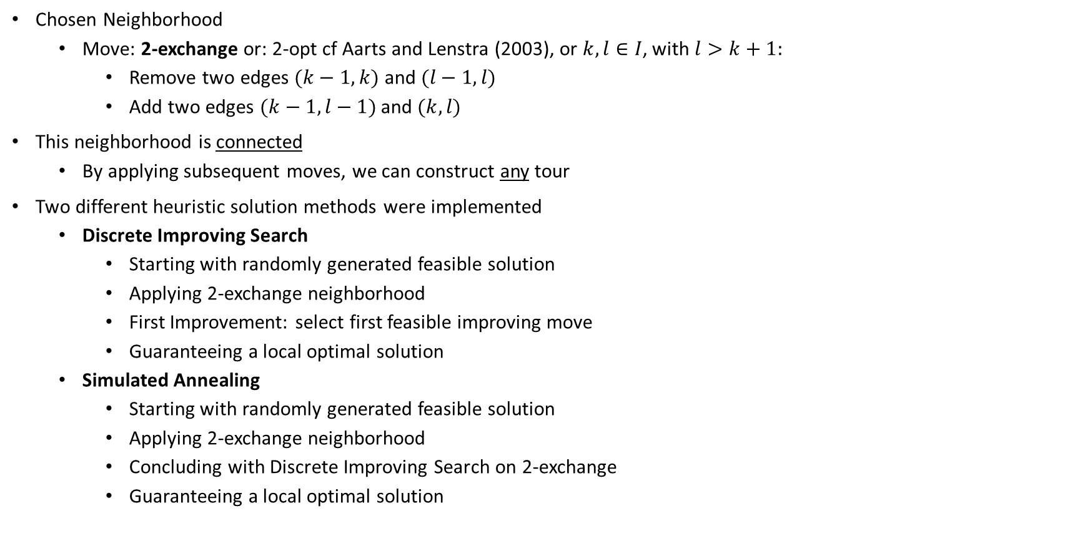
Design Heuristic based on Improving Search
Chosen Neighborhood
Move: 2-exchange or: 2-opt cf Aarts and Lenstra (2003), or $k,l∈I$, with $l>k+1:$
Remove two edges $(k−1,k)$ and $(l−1,l)$
Add two edges $(k−1,l−1)$ and $(k,l)$
This neighborhood is connected
By applying subsequent moves, we can construct any tour
Two different heuristic solution methods were implemented
Discrete Improving Search
Starting with randomly generated feasible solution
Applying 2-exchange neighborhood
First Improvement: select first feasible improving move
Guaranteeing a local optimal solution
Simulated Annealing
Starting with randomly generated feasible solution
Applying 2-exchange neighborhood
Concluding with Discrete Improving Search on 2-exchange
Guaranteeing a local optimal solution
Notes:
NL:
Ontwerp van heuristiek obv Improving Search

Slide 6
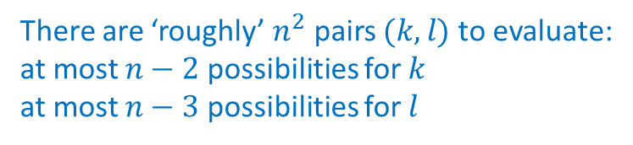
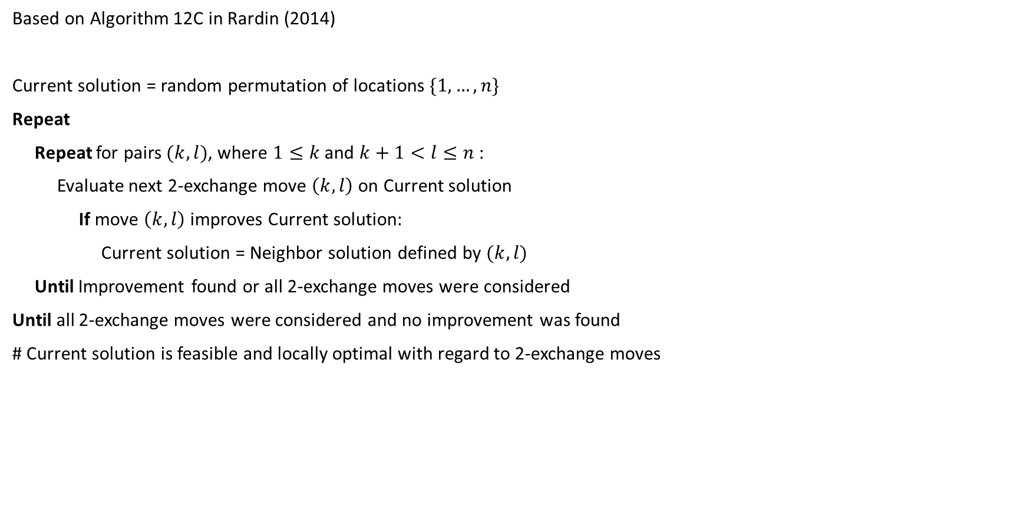
Discrete Improving Search: Logic
Time complexity solution method:
Exponential, because there is no bound on number of iterations and all solutions may be considered
Based on Algorithm 12C in Rardin (2014)
Current solution = random permutation of locations $\{1,…,n\}$
Repeat
Repeat for pairs $(k,l)$, where $1≤k$ and $k+1<l≤n$:
Evaluate next 2-exchange move $\left(k,l\right)$ on Current solution
If move $\left(k,l\right)$ improves Current solution:
Current solution = Neighbor solution defined by $(k,l)$
Until Improvement found or all 2-exchange moves were considered
Until all 2-exchange moves were considered and no improvement was found
# Current solution is feasible and locally optimal with regard to 2-exchange moves
There are ‘roughly’ $n^{2}$ pairs $(k,l)$ to evaluate:
at most $n−2$ possibilities for $k$
at most $n−3$ possibilities for $l$

Slide 7


Simulated Annealing: Logic
Based on Algorithm 12E in Rardin (2014)
Current solution, Best solution = random permutation of locations $\{1,…,n\}$
Initialize temperature: $T=T_{0}$
Repeat
Randomly generate a pair $(k,l)$, where $1≤k$ and $k+1<l≤n$:
Evaluate Neighbor solution by applying 2-exchange move $\left(k,l\right)$ on Current solution
$Δ$ = length Current solution - length Neighbor solution
If $Δ<0$ or with probability $e^{\frac{−Δ}{T}}$:
Current solution = Neighbor solution defined by $(k,l)$
If Current solution improves upon Best solution:
Best solution = Current solution
$T=T∗c$: Decrease temperature by cooling rate $0<c<1$
Until $T≤ε$ or Maximum number of iterations $M$ reached
Apply Discrete Improving Search to Best solution
# Best solution is feasible and locally optimal with regard to 2-exchange moves
Time complexity:
Bounded by $M$, maximum number of iterations. If $M=∞$, then time complexity is Exponential, because we may consider all possible solutions...
Time complexity: Exponential

Slide 8
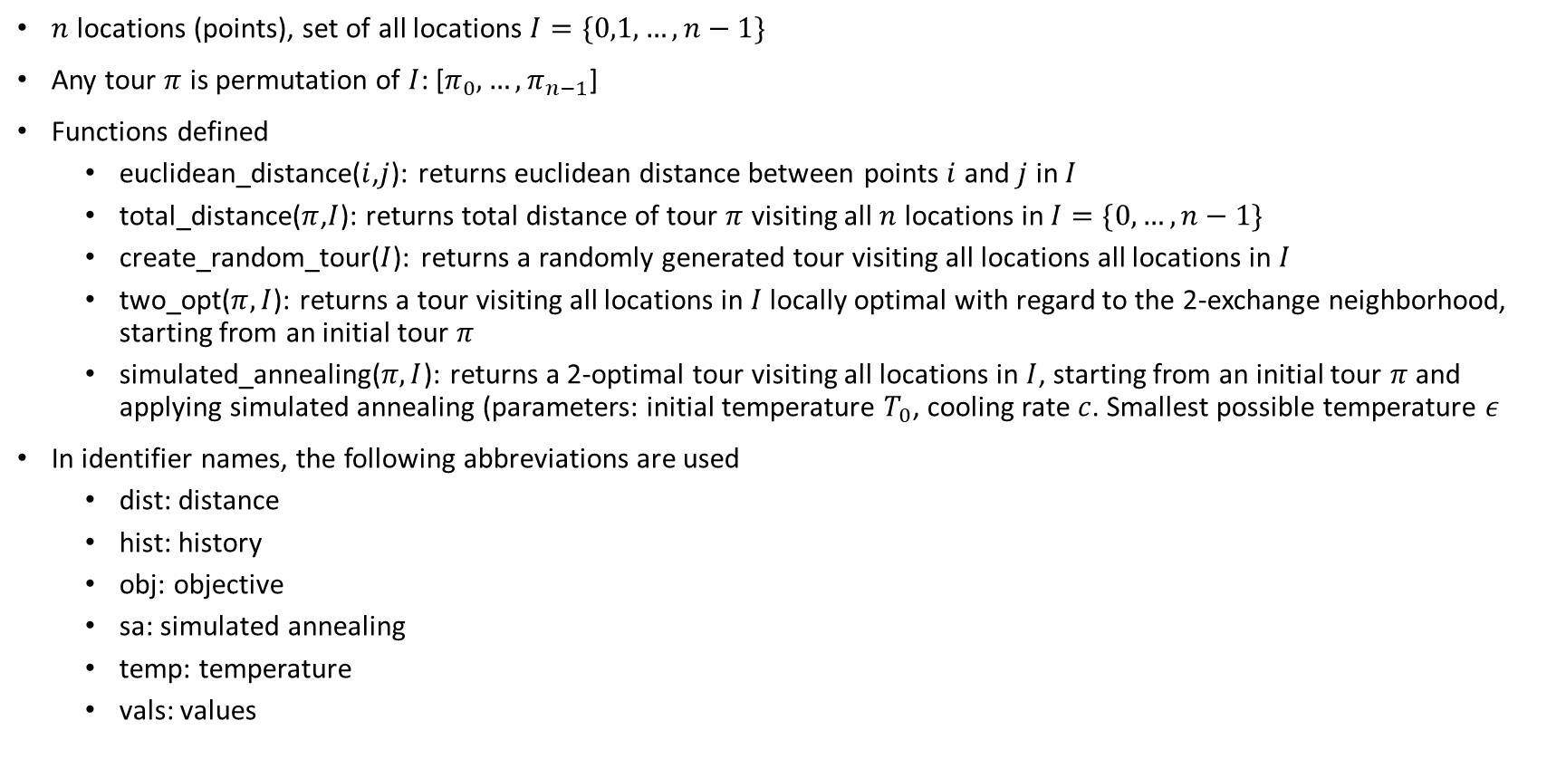
Python Implementation
$n$ locations (points), set of all locations $I=\{0,1,…,n−1\}$
Any tour $π$ is permutation of $I$: [$π_{0},…,π_{n−1}$]
Functions defined
euclidean_distance($i$,$j$): returns euclidean distance between points $i$ and $j$ in $I$
total_distance($π$,$I$): returns total distance of tour $π$ visiting all $n$ locations in $I=\{0,…,n−1\}$
create_random_tour($I$): returns a randomly generated tour visiting all locations all locations in $I$
two_opt($π,I$): returns a tour visiting all locations in $I$ locally optimal with regard to the 2-exchange neighborhood, starting from an initial tour $π$
simulated_annealing($π,I$): returns a 2-optimal tour visiting all locations in $I$, starting from an initial tour $π$ and applying simulated annealing (parameters: initial temperature $T_{0}$, cooling rate $c$. Smallest possible temperature $ε$
In identifier names, the following abbreviations are used
dist: distance
hist: history
obj: objective
sa: simulated annealing
temp: temperature
vals: values

Slide 9
Organization of code
There is one file, containing both implementation of Discrete Improving Search and Simulated Annealing
Discrete Improving Search is implemented in function two_opt
Simulated Annealing is implemented in simulated_annealing
Both solution methods are executed in main function:
def main():
# Create a TSP instance based on a given number of cities
points, x, y = define_tsp_instance()
# Create an initial tour (random permutation of points)
tour = create_random_tour(points, x, y)
# Apply simulated annealing to improve the tour
sa_tour, sa_distance = simulated_annealing(tour, points, x, y)
# Finally, apply 2-opt to make sure the tour is a local optimal solution
optimized_tour, optimized_distance = two_opt(sa_tour, points, x, y)
plt.show()
print("Optimized tour:", optimized_tour)
print("Total distance:", optimized_distance)
if __name__ == "__main__":
main()

Slide 10
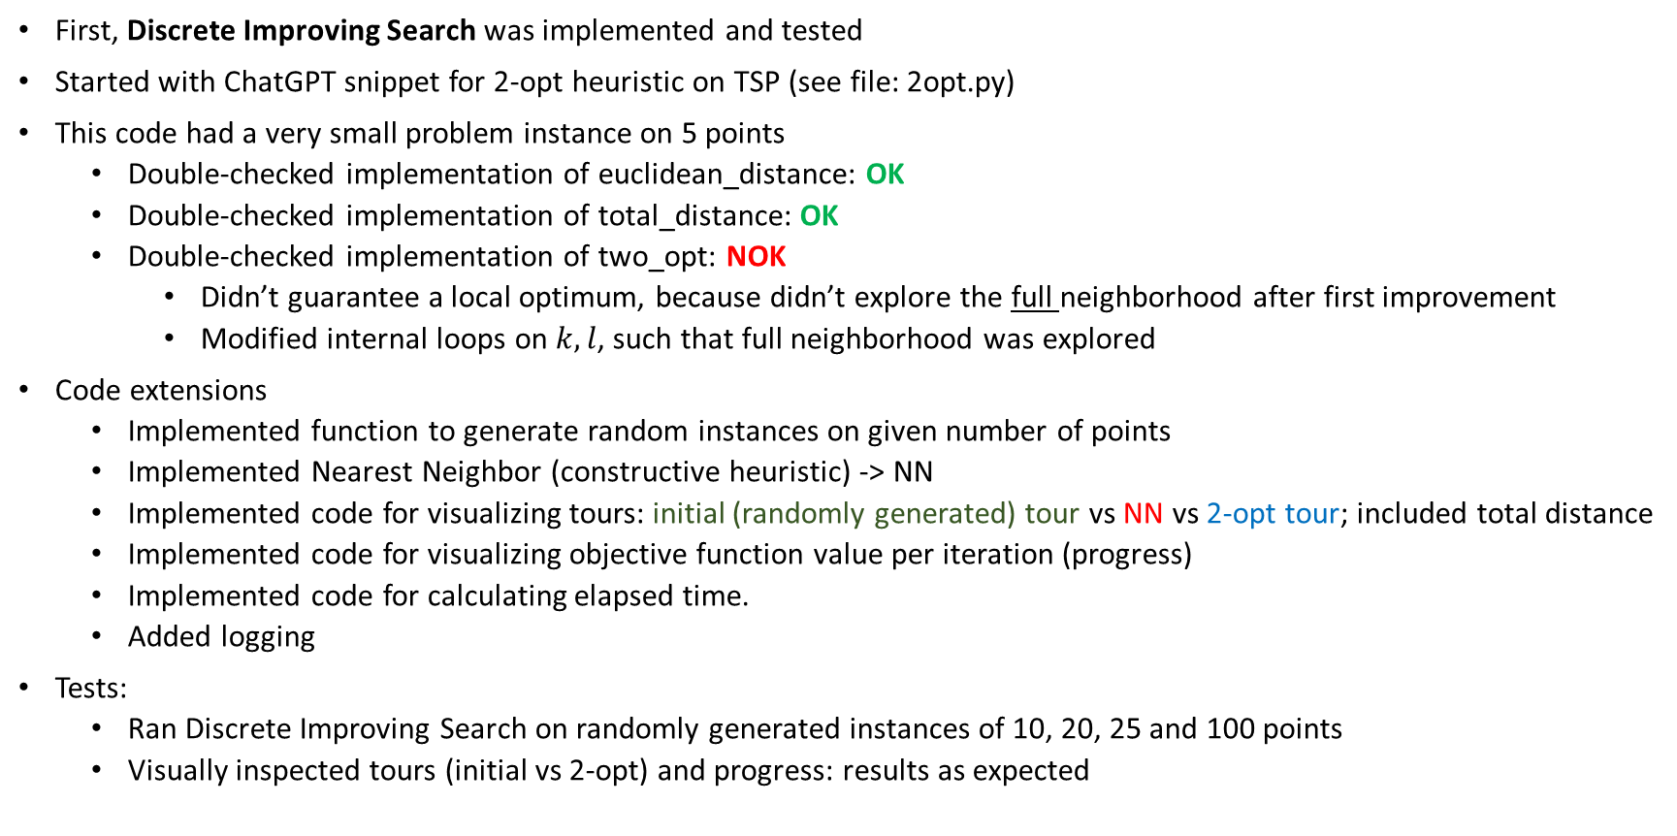
Tests and Experiments
First, Discrete Improving Search was implemented and tested
Started with ChatGPT snippet for 2-opt heuristic on TSP (see file: 2opt.py)
This code had a very small problem instance on 5 points
Double-checked implementation of euclidean_distance: OK
Double-checked implementation of total_distance: OK
Double-checked implementation of two_opt: NOK
Didn’t guarantee a local optimum, because didn’t explore the full neighborhood after first improvement
Modified internal loops on $k,l$, such that full neighborhood was explored
Code extensions
Implemented function to generate random instances on given number of points
Implemented Nearest Neighbor (constructive heuristic) -> NN
Implemented code for visualizing tours: initial (randomly generated) tour vs NN vs 2-opt tour; included total distance
Implemented code for visualizing objective function value per iteration (progress)
Implemented code for calculating elapsed time.
Added logging
Tests:
Ran Discrete Improving Search on randomly generated instances of 10, 20, 25 and 100 points
Visually inspected tours (initial vs 2-opt) and progress: results as expected

Slide 11
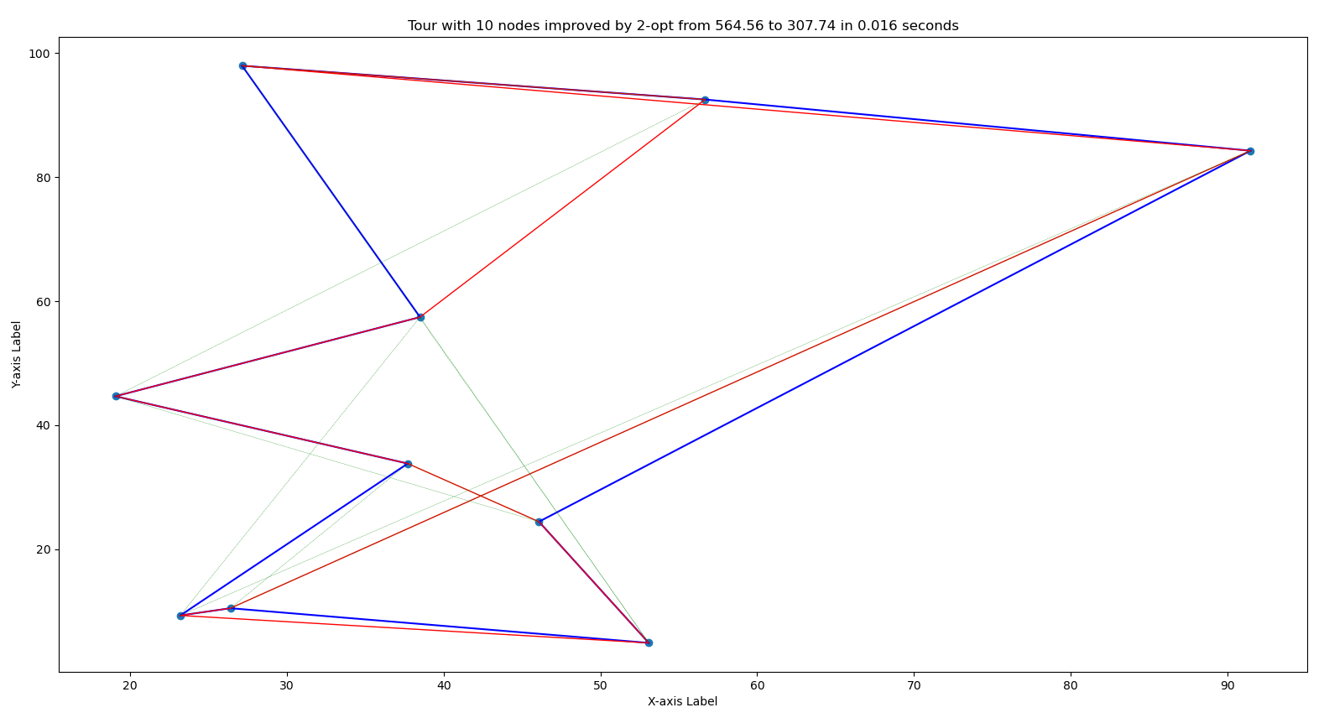
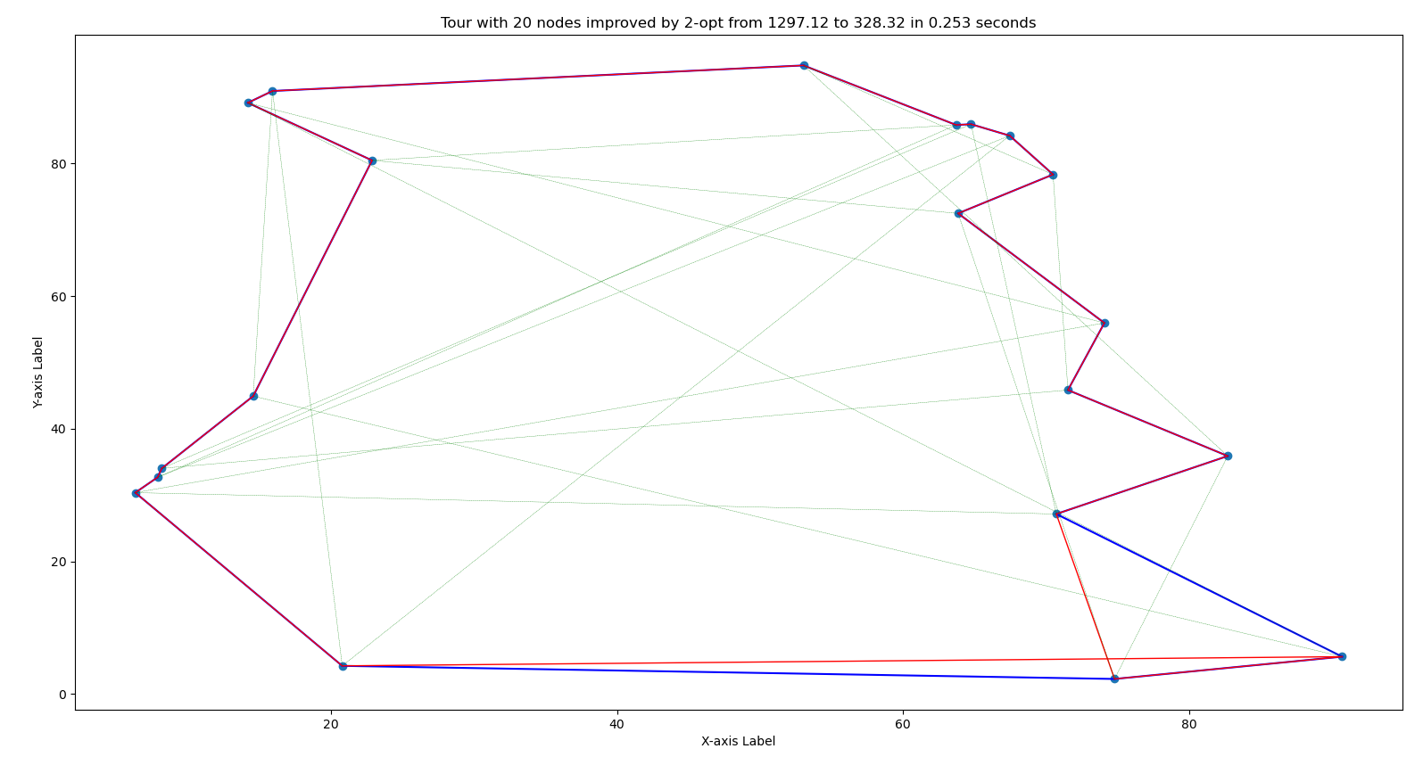
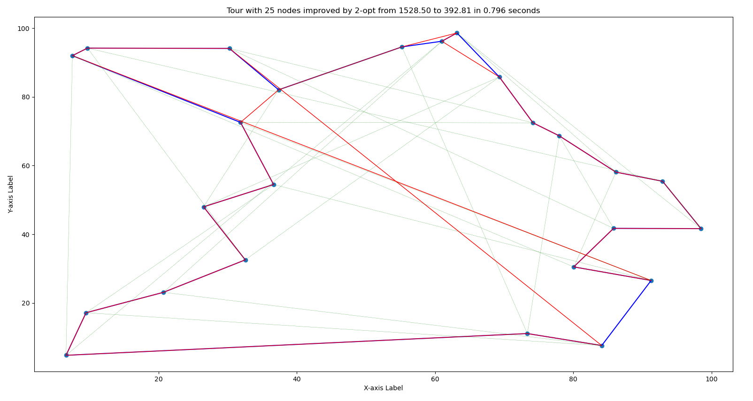
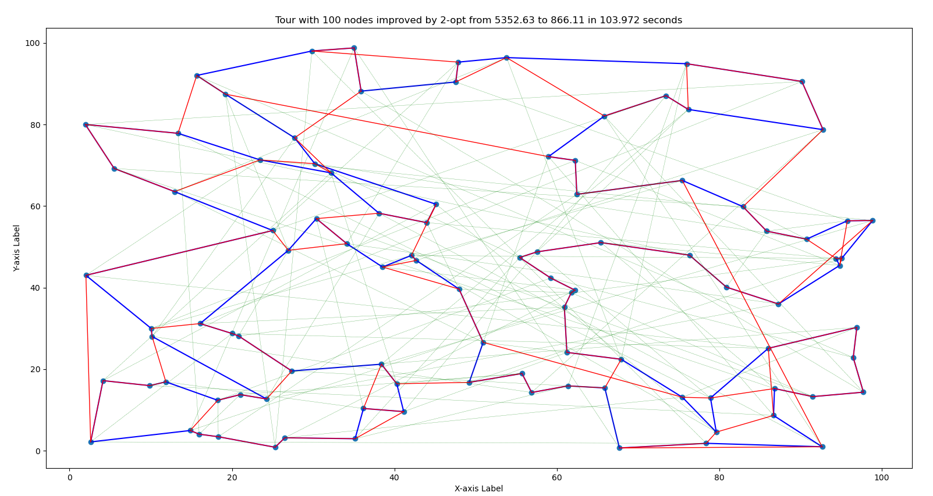
Discrete Improving Search: Tour visualisations
green: initial tour (random tour)
red: nearest neighbor tour
blue: 2-opt tour
Expectations met:
Nearest Neighbor tours have crossing links, 2-opt tours don’t. Huge improvement over randomly generated tours.

Slide 12
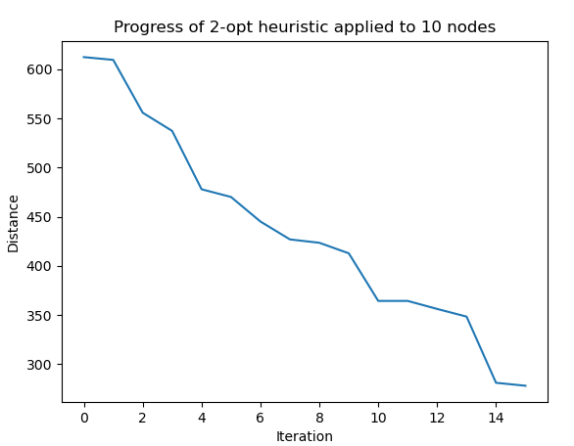
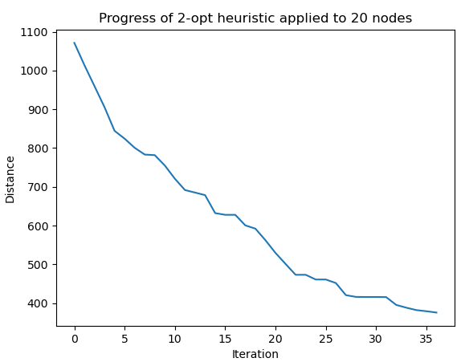
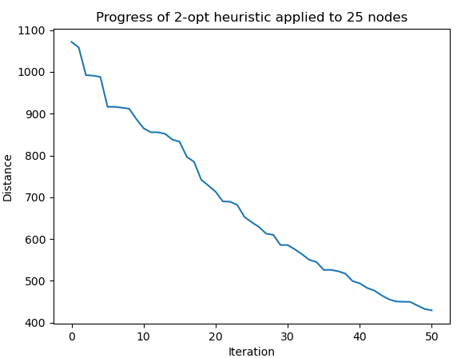
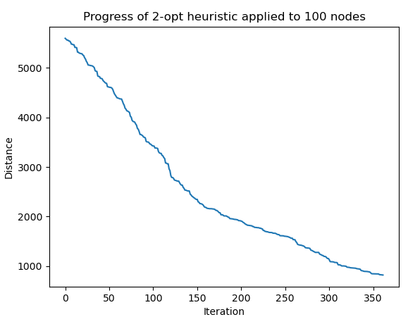
Discrete Improving Search: Objective value per iteration / Progress
Expectations met:
The higher the number of locations, the more iterations are needed. Objective value steadily decreases each iteration (no increase, no levels)

Slide 13
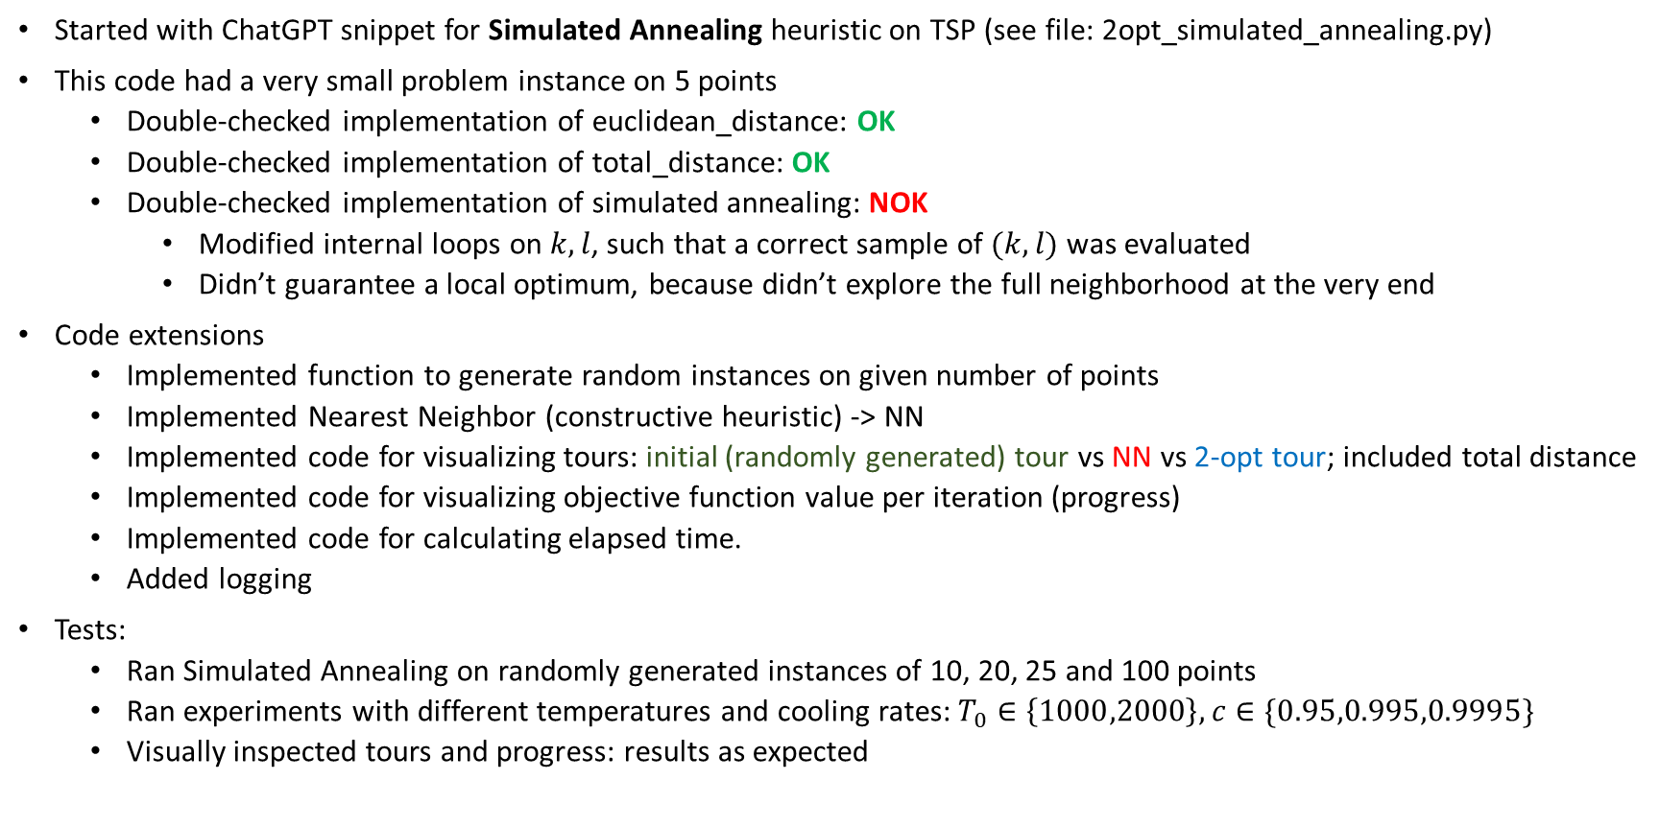
Tests and Experiments
Started with ChatGPT snippet for Simulated Annealing heuristic on TSP (see file: 2opt_simulated_annealing.py)
This code had a very small problem instance on 5 points
Double-checked implementation of euclidean_distance: OK
Double-checked implementation of total_distance: OK
Double-checked implementation of simulated annealing: NOK
Modified internal loops on $k,l$, such that a correct sample of $(k,l)$ was evaluated
Didn’t guarantee a local optimum, because didn’t explore the full neighborhood at the very end
Code extensions
Implemented function to generate random instances on given number of points
Implemented Nearest Neighbor (constructive heuristic) -> NN
Implemented code for visualizing tours: initial (randomly generated) tour vs NN vs 2-opt tour; included total distance
Implemented code for visualizing objective function value per iteration (progress)
Implemented code for calculating elapsed time.
Added logging
Tests:
Ran Simulated Annealing on randomly generated instances of 10, 20, 25 and 100 points
Ran experiments with different temperatures and cooling rates: $T_{0}∈\left\{1000,2000\right\},c∈\{0.95,0.995,0.9995\}$
Visually inspected tours and progress: results as expected

Slide 14
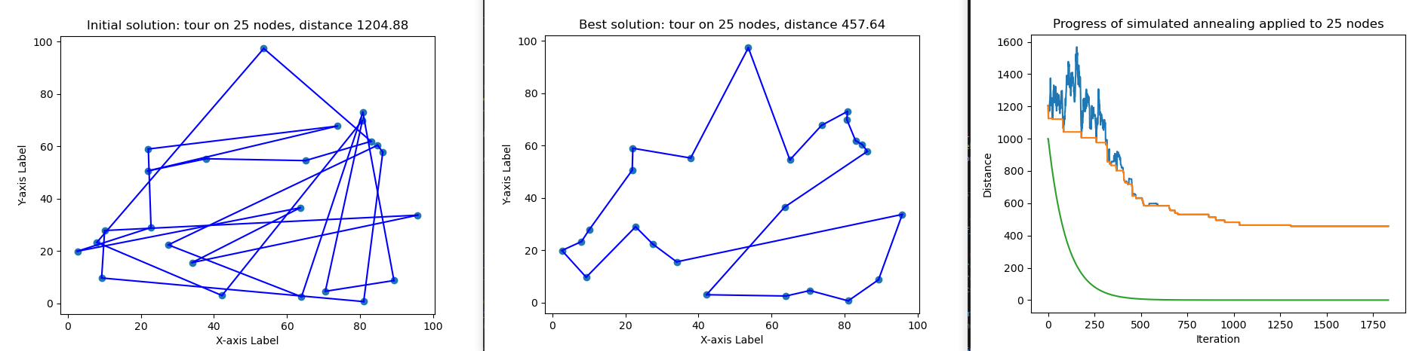
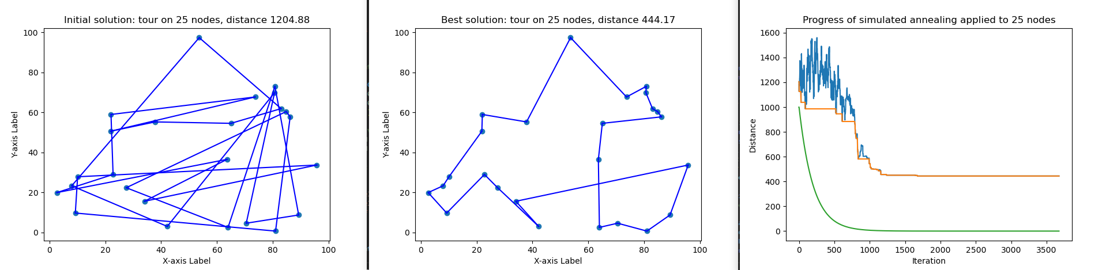
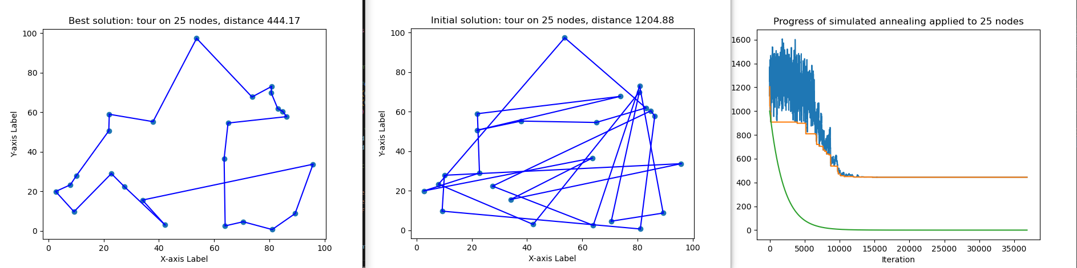



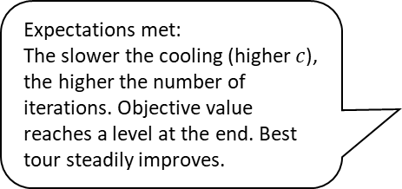
Simulated Annealing: Experiments on $n=25$ locations with $T_{0}=1000,c∈\left\{0.95,0.995,0.9995\right\}$
green: temperature
amber: best tour
blue: current tour
$$c=0.95$$
Expectations not met:
Simulated annealing returns a clearly not-2-optimal tour as best solution. Apparently, we need to execute Discrete Improving Search to guarantee local optimum
$$c=0.995$$
Expectations met:
The slower the cooling (higher $c$), the higher the number of iterations. Objective value reaches a level at the end. Best tour steadily improves.
$$c=0.9995$$

Slide 15
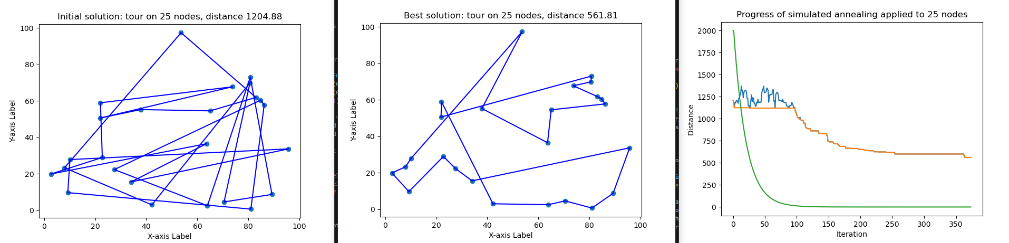
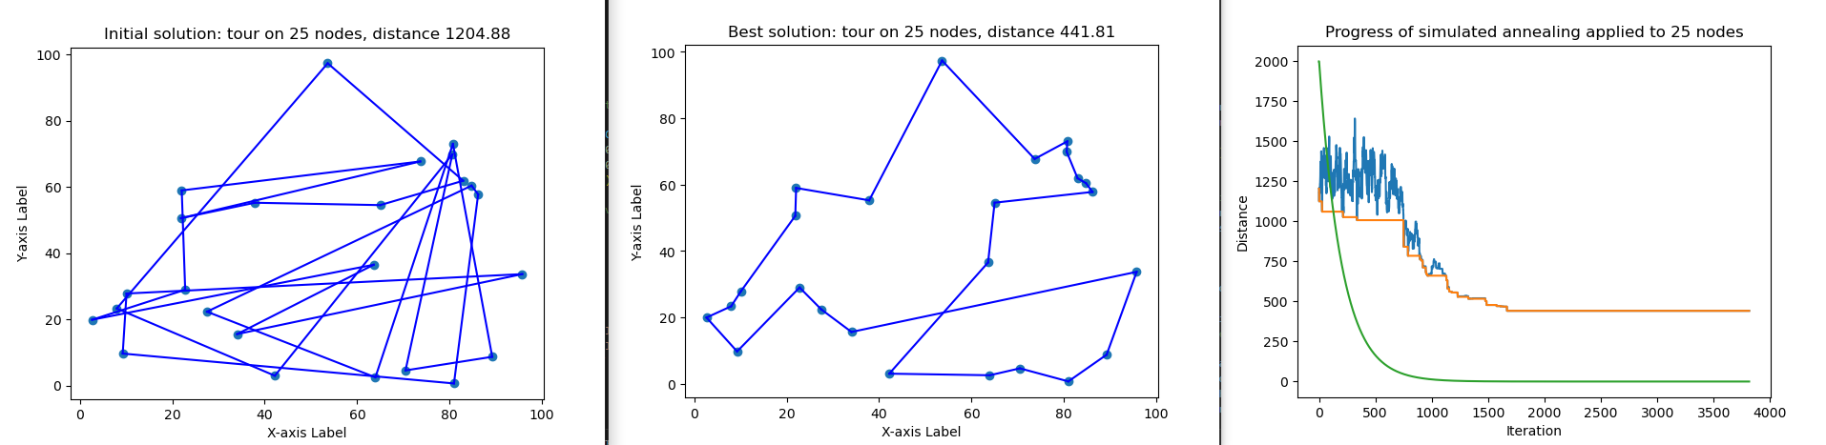
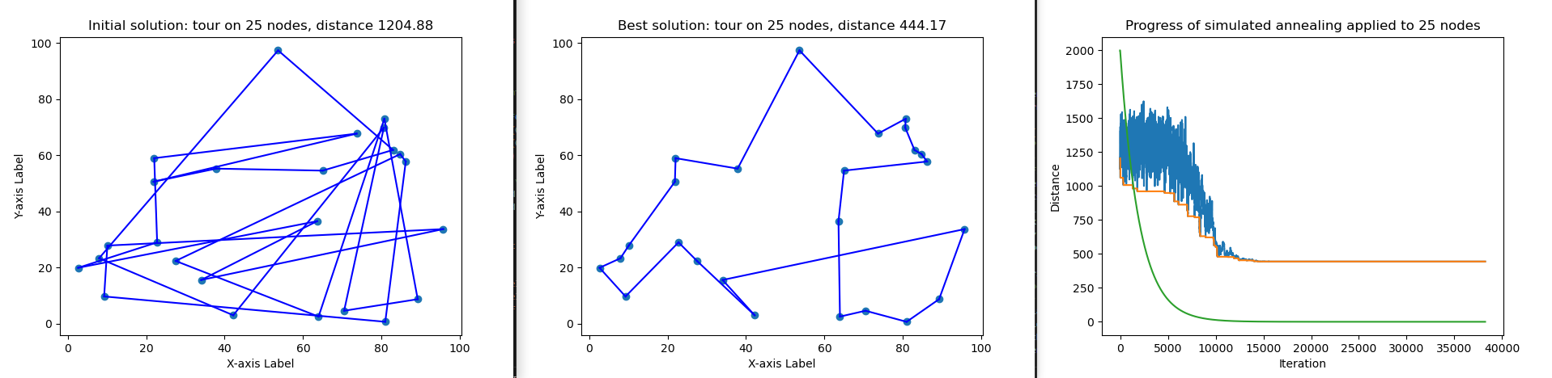



Simulated Annealing: Experiments on $n=25$ locations with $T_{0}=2000$
$$c=0.95$$
$$c=0.995$$
$$c=0.9995$$

Slide 16
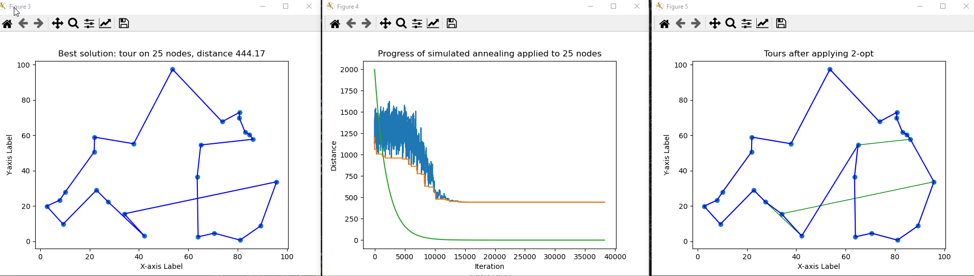
Concluding Simulated Annealing with Discrete Improving Search returns local optimal tour
Best solution after executing simulated annealing

Slide 17
Realised Depth in OR
Implemented constructive heuristic Nearest Neighbor
Implemented Simulated Annealing
Compared performance between Nearest Neighbor, Discrete Improving Search, Simulated Annealing based on a number of experiments

